Slide 1
Forecasting Analytics
Session 6

Slide 2
Forecasting yearly sales: Reynolds Metals Company
Year | Total sales in a region (X) | Disposable personal income in region (Y) | Year | Total sales in a region (X) | Disposable personal income in region (Y)
1986 | 295 | 273.4 | 1997 | 1528 | 510.4
1987 | 400 | 291.3 | 1998 | 1586 | 544.5
1988 | 390 | 306.9 | 1999 | 1960 | 588.1
1989 | 425 | 317.1 | 2000 | 2118 | 630.4
1990 | 547 | 336.1 | 2001 | 2116 | 685.9
1991 | 555 | 349.4 | 2002 | 2477 | 742.8
1992 | 620 | 362.9 | 2003 | 3199 | 801.3
1993 | 720 | 383.9 | 2004 | 3702 | 903.1
1994 | 880 | 402.8 | 2005 | 3316 | 983.6
1995 | 1050 | 437 | 2006 | 2702 | 1076.7
1996 | 1290 | 472.2

Slide 3
Forecasting yearly sales: Reynolds Metals (contd.)
Data given in Table 8.1
One can build a linear model relating sales to time

Slide 4
Forecasting yearly sales: Reynolds Metals (contd.)
Data on disposable personal income is also available
One can build a linear model relating sales to income

Slide 5

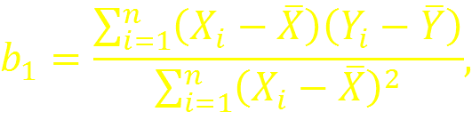


Simple linear regression: recapitulation
Model:
Parameter estimates:
Fitted equation:

Slide 6


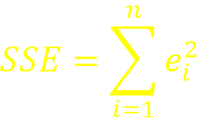
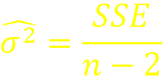
Simple linear regression: recapitulation (contd.)
Fitted values and residuals
Sum of squared ‘errors’
Estimated error variance:

Slide 7
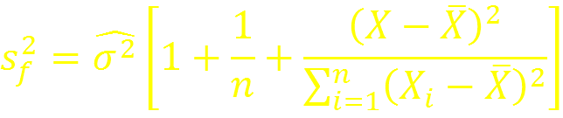

Simple linear regression: recapitulation (contd.)
Prediction of Y for given X :
Estimated prediction error variance
Prediction interval (coverage probability 1 – α)

Slide 8
Example: How mail orders depend on catalog distribution
Number of catalogs distributed in thousand (X) | Number of mail orders received in thousand (Y)
6 | 24
2 | 16
5 | 23
1 | 15
10 | 32
7 | 25
15 | 18
3 | 18
11 | 35
13 | 34
2 | 15
12 | 32
b₀ = 15.8462
b₁ = 1.1132
Multiple R² = 0.4893
Estimated σ ² = 5.757

Slide 9
Prediction/forecast of mail orders for different values of X
Prediction interval is wider at the extreme ends (s_{f} is larger)
‘Within sample’ prediction is better than ‘out-of-sample’ prediction
Even with large data, prediction interval cannot have zero width

Slide 10
Experiment: Increase sample size artificially by multiplying data
When the data are replicated ten times to increase sample size n artificially, prediction intervals have about the same length for all X.
However, that length is never zero.
Parameter estimation error reduces, but effect of σ ² has to be factored in.
As for extrapolation, model validity is an issue.

Slide 11
Re-visit yearly sales of Reynolds Metals Company
Year | Total sales in a region (X) | Disposable personal income in region (Y) | Year | Total sales in a region (X) | Disposable personal income in region (Y)
1986 | 295 | 273.4 | 1997 | 1528 | 510.4
1987 | 400 | 291.3 | 1998 | 1586 | 544.5
1988 | 390 | 306.9 | 1999 | 1960 | 588.1
1989 | 425 | 317.1 | 2000 | 2118 | 630.4
1990 | 547 | 336.1 | 2001 | 2116 | 685.9
1991 | 555 | 349.4 | 2002 | 2477 | 742.8
1992 | 620 | 362.9 | 2003 | 3199 | 801.3
1993 | 720 | 383.9 | 2004 | 3702 | 903.1
1994 | 880 | 402.8 | 2005 | 3316 | 983.6
1995 | 1050 | 437 | 2006 | 2702 | 1076.7
1996 | 1290 | 472.2

Slide 12
Linear regression fit

Slide 13
Plot of residuals
Evidence of unequal variance (heteroscdasticity)

Slide 14
How to deal with heteroscedasticity?
Try weighted regression?
Try transformation of Y?
Take an easy route: try log-transformation of both X and Y.

Slide 15
Analysis of log-transformed data: Fitted values and residuals
How to deal with the pattern in the residuals?
Try polynomial regression?
Explore correlation in residuals?

Slide 16
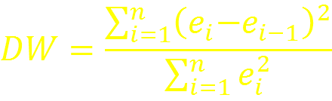
Check correlation of residuals
ACF at lag 1 is significant.
A specialized test for ‘serial correlation’ at lag 1 is Durbin-Watson test:
The statistic has value
in between 0 and 4;
Near 0 when there is positive correlation between successive samples;
Near 4 when there is negative correlation;
Near 2 when there is little or no correlation.
Table B-6 in Appendix B gives critical values.
For this data, DW = 0.4699, p-value = 1.058e-06.

Slide 17



How to deal with autocorrelation?
Try a simple AR(1) model for the residuals
Fitted model is
By putting together the equations
We have

Slide 18
Diagnostics with modified data

Slide 19
Forecasts: Reynolds Metals
Suppose income for the year 2007 is 1150.

Slide 20
Three forecasts

